Slide 1

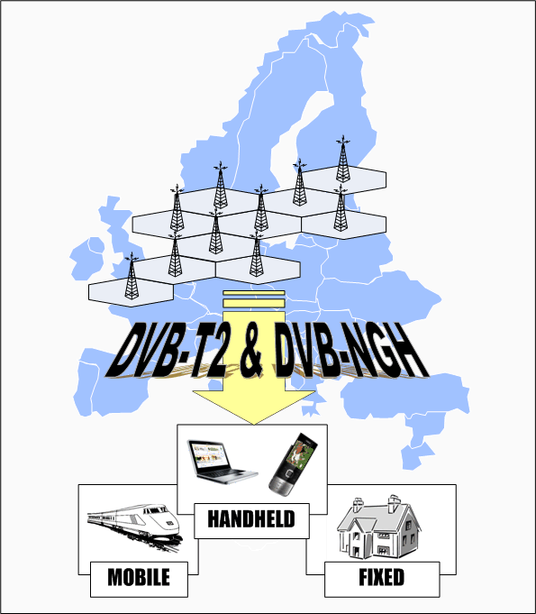
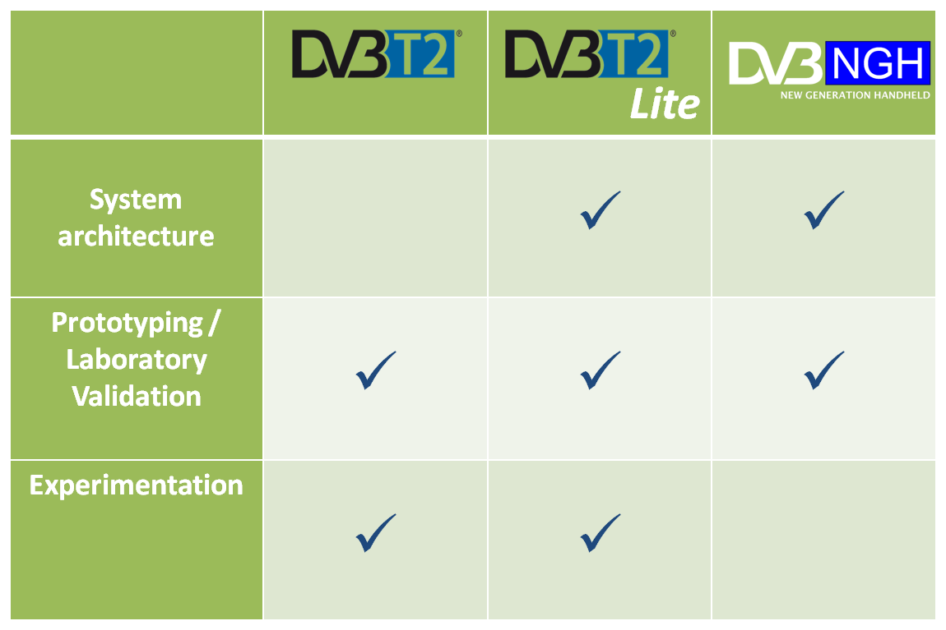
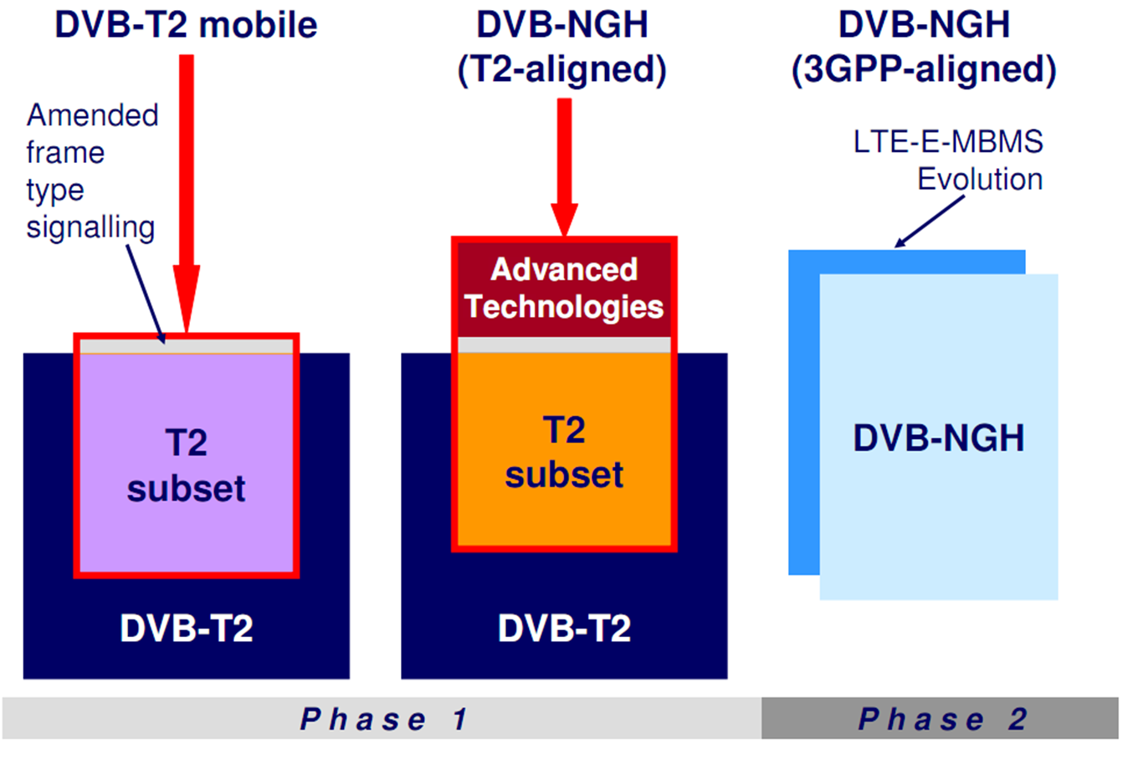
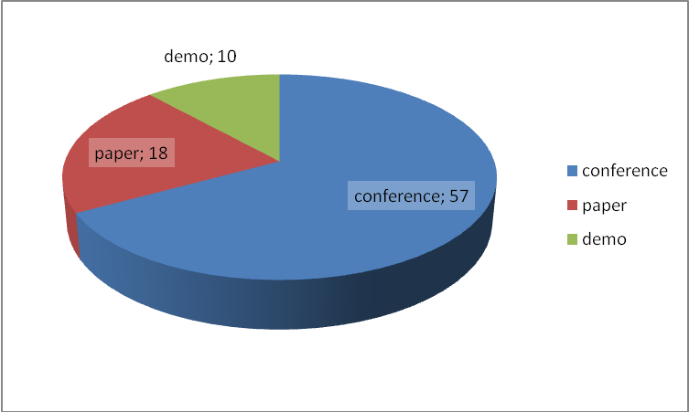






























ENGINES
(Enabling Next GeneratIon NEtworks for broadcast Services)
Development of DVB*-T2Lite and DVB « Next Generation Handheld (DVB-NGH) » standards and support validation of advanced DVB-T2 functions
Main Focus:
Supporting worldwide deployment and DVB effort of high capacity broadcast networks (DVB-T2/T2Lite/NGH) for hybrid fixed-mobile reception scenario (DVB-T2Lite) or next generation Handheld (DVB-NGH).
Development, verification and validation of Technical Concepts and Elements coming from expected DVB-NGH « Next Generation Handheld » standard (MIMO techniques, verify the use of TFS)
Verification and validation of full DVB-T2 “Second Generation Terrestrial “ standard (verify TFS parts of DVB-T2 specs, MPLP, PAPR features)
ENGINES
Project ID: CP7-005
Start Date: 1 January 2010
Completion date: 31 Dec 2012
Partners:
Abo Akademi University, FI
Abertis Telecom, SP
Axel Technologies, FI
BBC, UK
CNES, FR
DiBcom, FR
Digialist, FI
Digita, FI
Elektrobit, FI
ENENSYS Technologies, FR
FranceTelecom R&D, FR
Hispasat, SP
INSA/IETR, FR
Integrasys, SP
Media Broadcast, DE
Mier Comunicaciones, SP
Mitsubishi Electric R&D, FR
Nokia, FI
RAI, IT
Sony SDC, UK
Suomen Schneider, FI
Tampere University of Technology, FI
TDF, FR
Teamcast, FR
Telecom Bretagne, FR
Teleste, FI
Teracom, SE
Thomson Broadcast, FR
Turku University Applied Sciences, FI
Universidad del Pais Vasco, SP
University of Turku, FI
Univer. Politecnica de Valencia, SP
Universidad Ramon LLull, SP
Coordinator
Jani Väre, Nokia, Finland
e-mail: jani.vare@nokia.com
Project web Site
www. celtic-engines.org
Main Results
Significant amount of contributions to DVB-T2 Lite and DVB-NGH standardization
Channel model creation for MIMO and LMS (Land mobile Satellite) scenarios
Studies on DVB-NGH building blocks, such as SC-OFDM, MIMO, TFS, SVC with multiple PLPs among others
Studies on emerging technologies
Convergence of broadcast and mobile networks
Spectrum white space utilization
Collecting simulation, lab and field trials on DVB-T2, T2 Lite and NGH
11 prototypes – commercial product already during the project
Field and laboratory measurement campaigns
Dissemination presentations on major broadcast events and scientific forums (conferences, journals)
Lite

