Slide 1

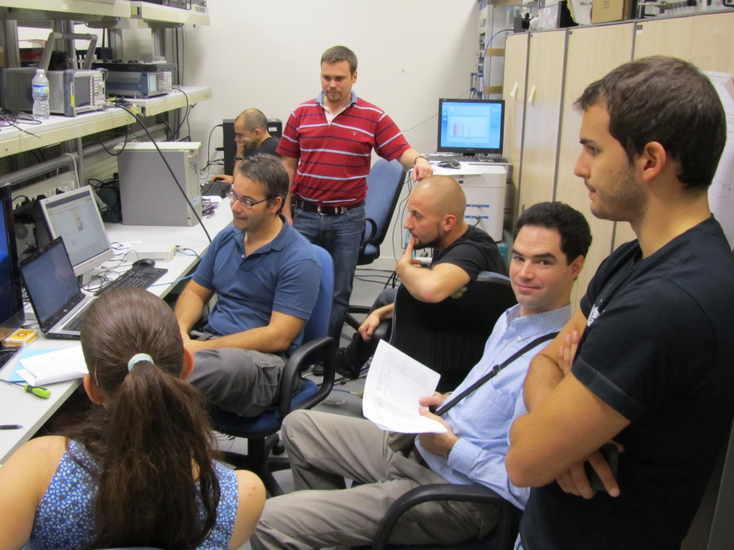
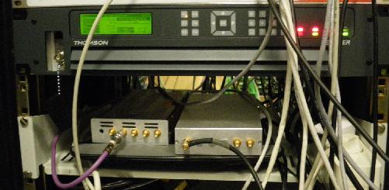
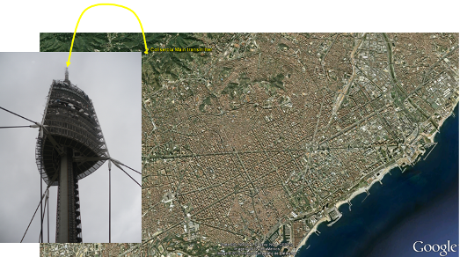
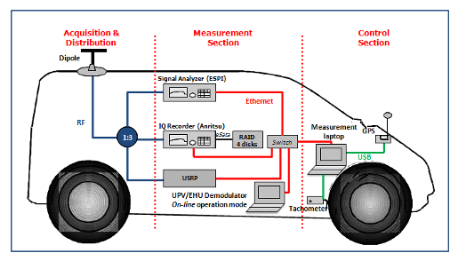
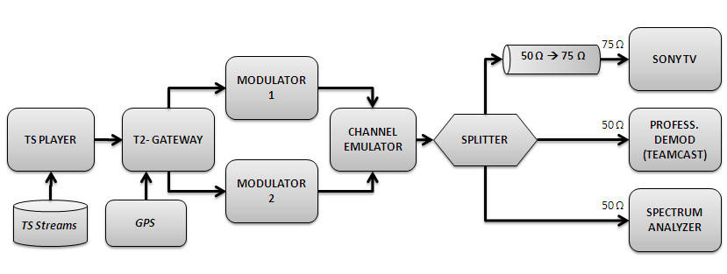
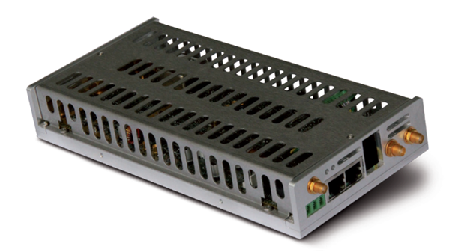
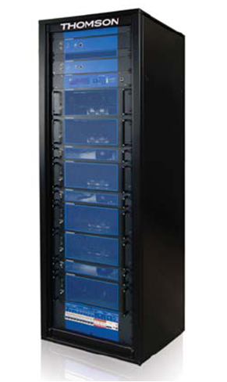
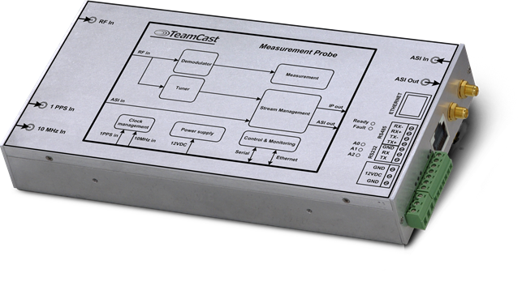

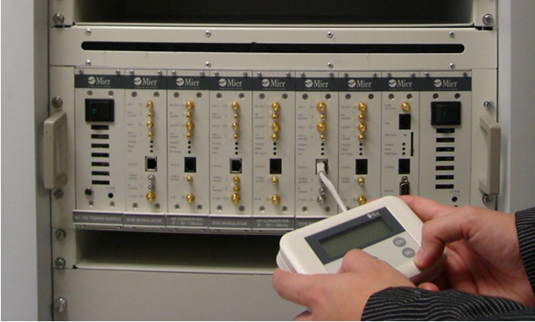
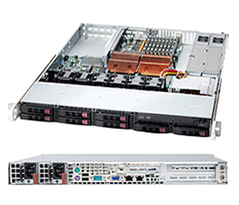
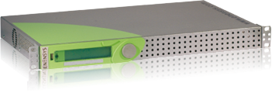







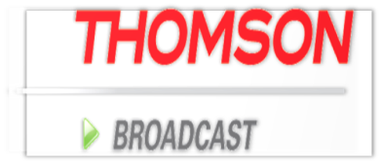






















ENGINES
(Enabling Next GeneratIon NEtworks for broadcast Services)
Projects results highlights
Plug fests
Measurement campaigns
Two Plug Fests carried out
  Oct.2011 (Barcelona) - “DVB-T2 Advanced Features Lab Test”
    Features tested: PAPR, Null FEFs, Multiple PLP, SFN, T2-MI.
  Sep./Dec.2012 (Barcelona/Rennes) - “NGH-Ph.1 Lab Test”
    Features tested: T2-Lite, Mixed T2-Base/T2-Lite, SFN, SC-OFDM.
Two Measurements Campaigns carried out
  Nov.2011(Barcelona) - “DVB-T2 Advanced Features Field Trials”
    Features tested: Multiple PLP.
  Sep./Oct.2012 (Barcelona) - “T2-Lite Field Trials”
    Features tested: T2-Lite, Mixed T2-Base/T2-Lite, SFN
Simulation and Validation
Prototypes
Test of TFS (Time and Frequency Slicing)
TFS consists of sending a large content streams (up to 200MB/s) across several discontinuous UHF frequencies . This allows to average the SNR and gain bitrate in channel with higher propagation loss .
11 prototypes, from 15 contributing organisations
Teamcast DVB-T2 modulator
MIMO channel modelling and validation of MIMO schemes for DVB-NGH
2x2 MIMO channel sounding in Helsinki (2010)
Simulation of MIMO coding schemes for DVB-NGH
Thomson Broadcast DVB-T2 transmitter
Teamcast DVB-T2 demodulator
BBC R&D MIMO Modulator
Mier DVB-T2 transmitter
Datapilot
DVB-T
modulator
Inv
Backend
Tx0
PA
VP
Antenna
Channel
Cross-polar
Application Antenna
Transmit Side
Backend
Tx1
PA
HP
Antenna
Rx0
2x2 MIMO
Channel Sounding
Control
Laptop
EB
Channel Recorder
Rx1
Splitter
RF Frontend
Real-time
Channel Display
BBC
MIMO Receiver
Rx0
Rx1
RF Frontend
Receive Side
LaSalle DVB-T2 Gateway
Test of the SC-OFDM platform
SC-OFDM test platform in MERCE Rennes
Validation of the satellite component for DVB-NGH
Mier DVB-T2 gapfiller
Enensys DVB-T2 Gateway

