Slide 1



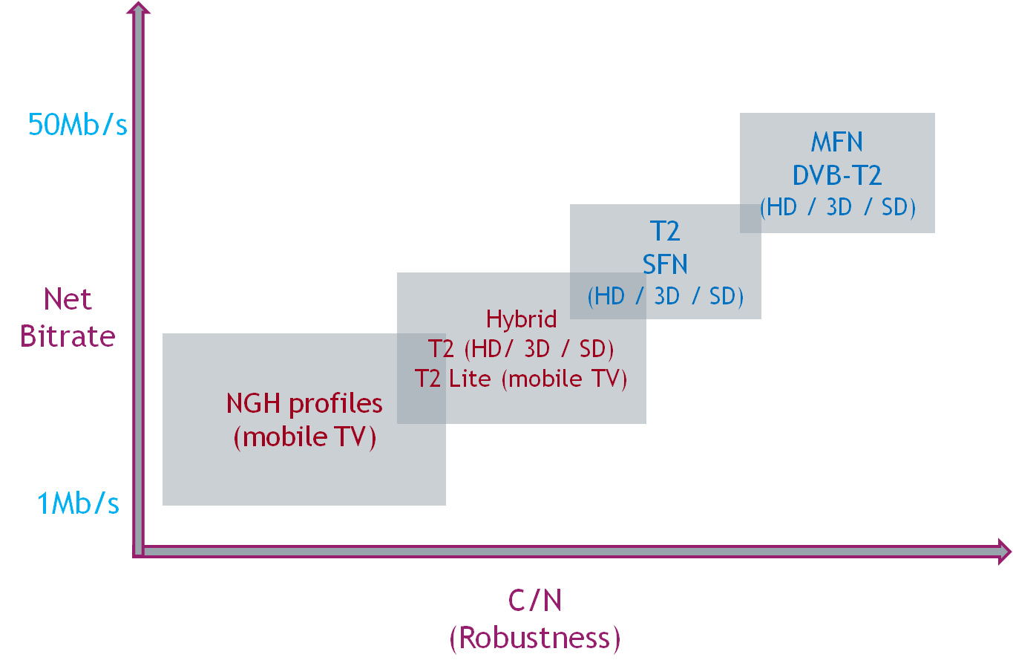

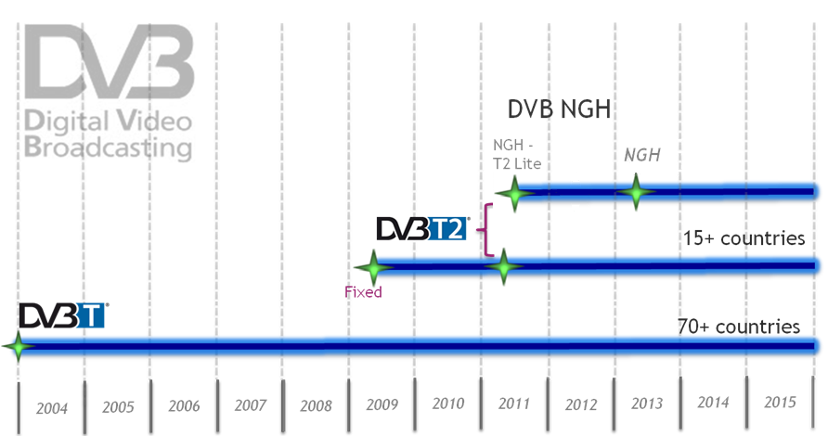






























&
Designed to address the new mobile broadcast services
It is expected that by the 2015 timeframe, Rich Media content consumption will increase several-fold and the content will be consumed using a variety of devices. To facilitate this Rich media content consumption, an efficient, flexible and robust Next Generation Handheld (NGH) system is needed to accompany digital switchover and convergence of fixed and mobile services as well as telecommunication services.
DVB-T2Lite (2011) standard and DVB-NGH specification are designed to operate at least in the frequency bands III, IV and V, L-band and S-band.
DVB-NGH is designed to operate with RF channel bandwidths of 1.7, 5, 6, 7, 8, 10, 15 and 20 MHz. It shall meet interference levels and spectrum mask requirements as defined by GE06 (and hence not cause more interference than DVB-T or T-DAB would do).
Contributions through ENGINES and outputs to Standardisation bodies
In order to fulfil the NGH commercial requirements, the DVB Project issued a Call for Technologies in Nov. 2009. This call intended to invite technology inputs that would facilitate an appropriate NGH physical layer on which a successful full NGH system could be built.
33 proposals were submitted to the CfT, out of which 26 from 19 ENGINES Project Partners. During the standardization process over 100 technical contributions were presented to DVB by the ENGINES Project Partners.
Main studies: MIMO – PAPR – Rotated Constellation – Modulation – T2 / NGH compatibility – TFS – ROHC– Physical layer inter-leaver, BBiFEC – Turbo codes – SC OFDM frame (satellite and hybrid terrestrial/satellite) – T2 functional improvement for mobile performance - Synchronisation mechanisms – FEF

