Slide 1
Student Xperience
thomas.westerholm@abo.fi
8.9.2023

Slide 2
Problem
Too many (unstandardized) diferrent, nonsynchronized interaction channels
Challenging to navigate and to find needed information
Utilizing opportunities for personalized learning
Understanding student retaining
Data not utilized holistically
Manual processes

Slide 3
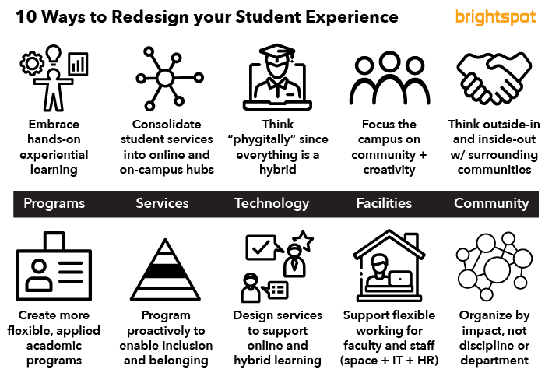

Slide 4
Goal
Analyze Åbo Akademi’s student experience. Select parts for deeper investigation
Demonstrate through a demo what next gen student experience could/should be
And possibly: Demonstrate how automation and data analysis could support improving student experience

Slide 5
Xm Predictor
thomas.westerholm@abo.fi
8.9.2023

Slide 6
Problem
A major part of the university’s finance is based on produced Bachelor and Masters degrees
A lot of data is available, but currently it is analyzed in silos. Manually.
Data not easily available for analyzing on lower levels in the organization
Exam predictions mainly based on gut feeling
→ Poor input for financial planning

Slide 7
Trend och prognos: LH och HH
Mål, utfall och progonos
3 års rullande medeltal
Mål LH
Mål LH
Mål HH
Mål HH
HH trend
HH trend
LH trend
HH prognos
LH trend
HH prognos
LH prognos
LH prognos
LH = lägre högskole examen
HH = högre högskole examen
2019-2022 = årligt utfall
2023P = prognos för 2023
Prognosmodellen baserar sej på de tre tidigare årens examinationsprofil, genomströmningens utveckling samt utvecklingen av antalet inskrivna studerande (prognosmodell 20230510).

Slide 8
Goal
Build a model to predict exam production based on student enrolment, study progress and examination history. Analyze other data utilization to improve the model.
Test and demonstrate the model on real data, on selected degree programs
Build an interface targeting different usergroups
Possibly: What would a personal prediction give the student themselves?

