Slide 1
Student Projects @ AboaMare
RJA 17 Feb 2021
robert.aarts@novia.fi

Slide 2
R&D @ AboaMare
Applied research in smart shipping
Human factors, procedures
Decision support, information enhancement, situational awareness
VR/AR for training and operations
Standardization

Slide 3
Vessel Remote Guidance Protocol

Slide 4
Protocol and implementations

Slide 5
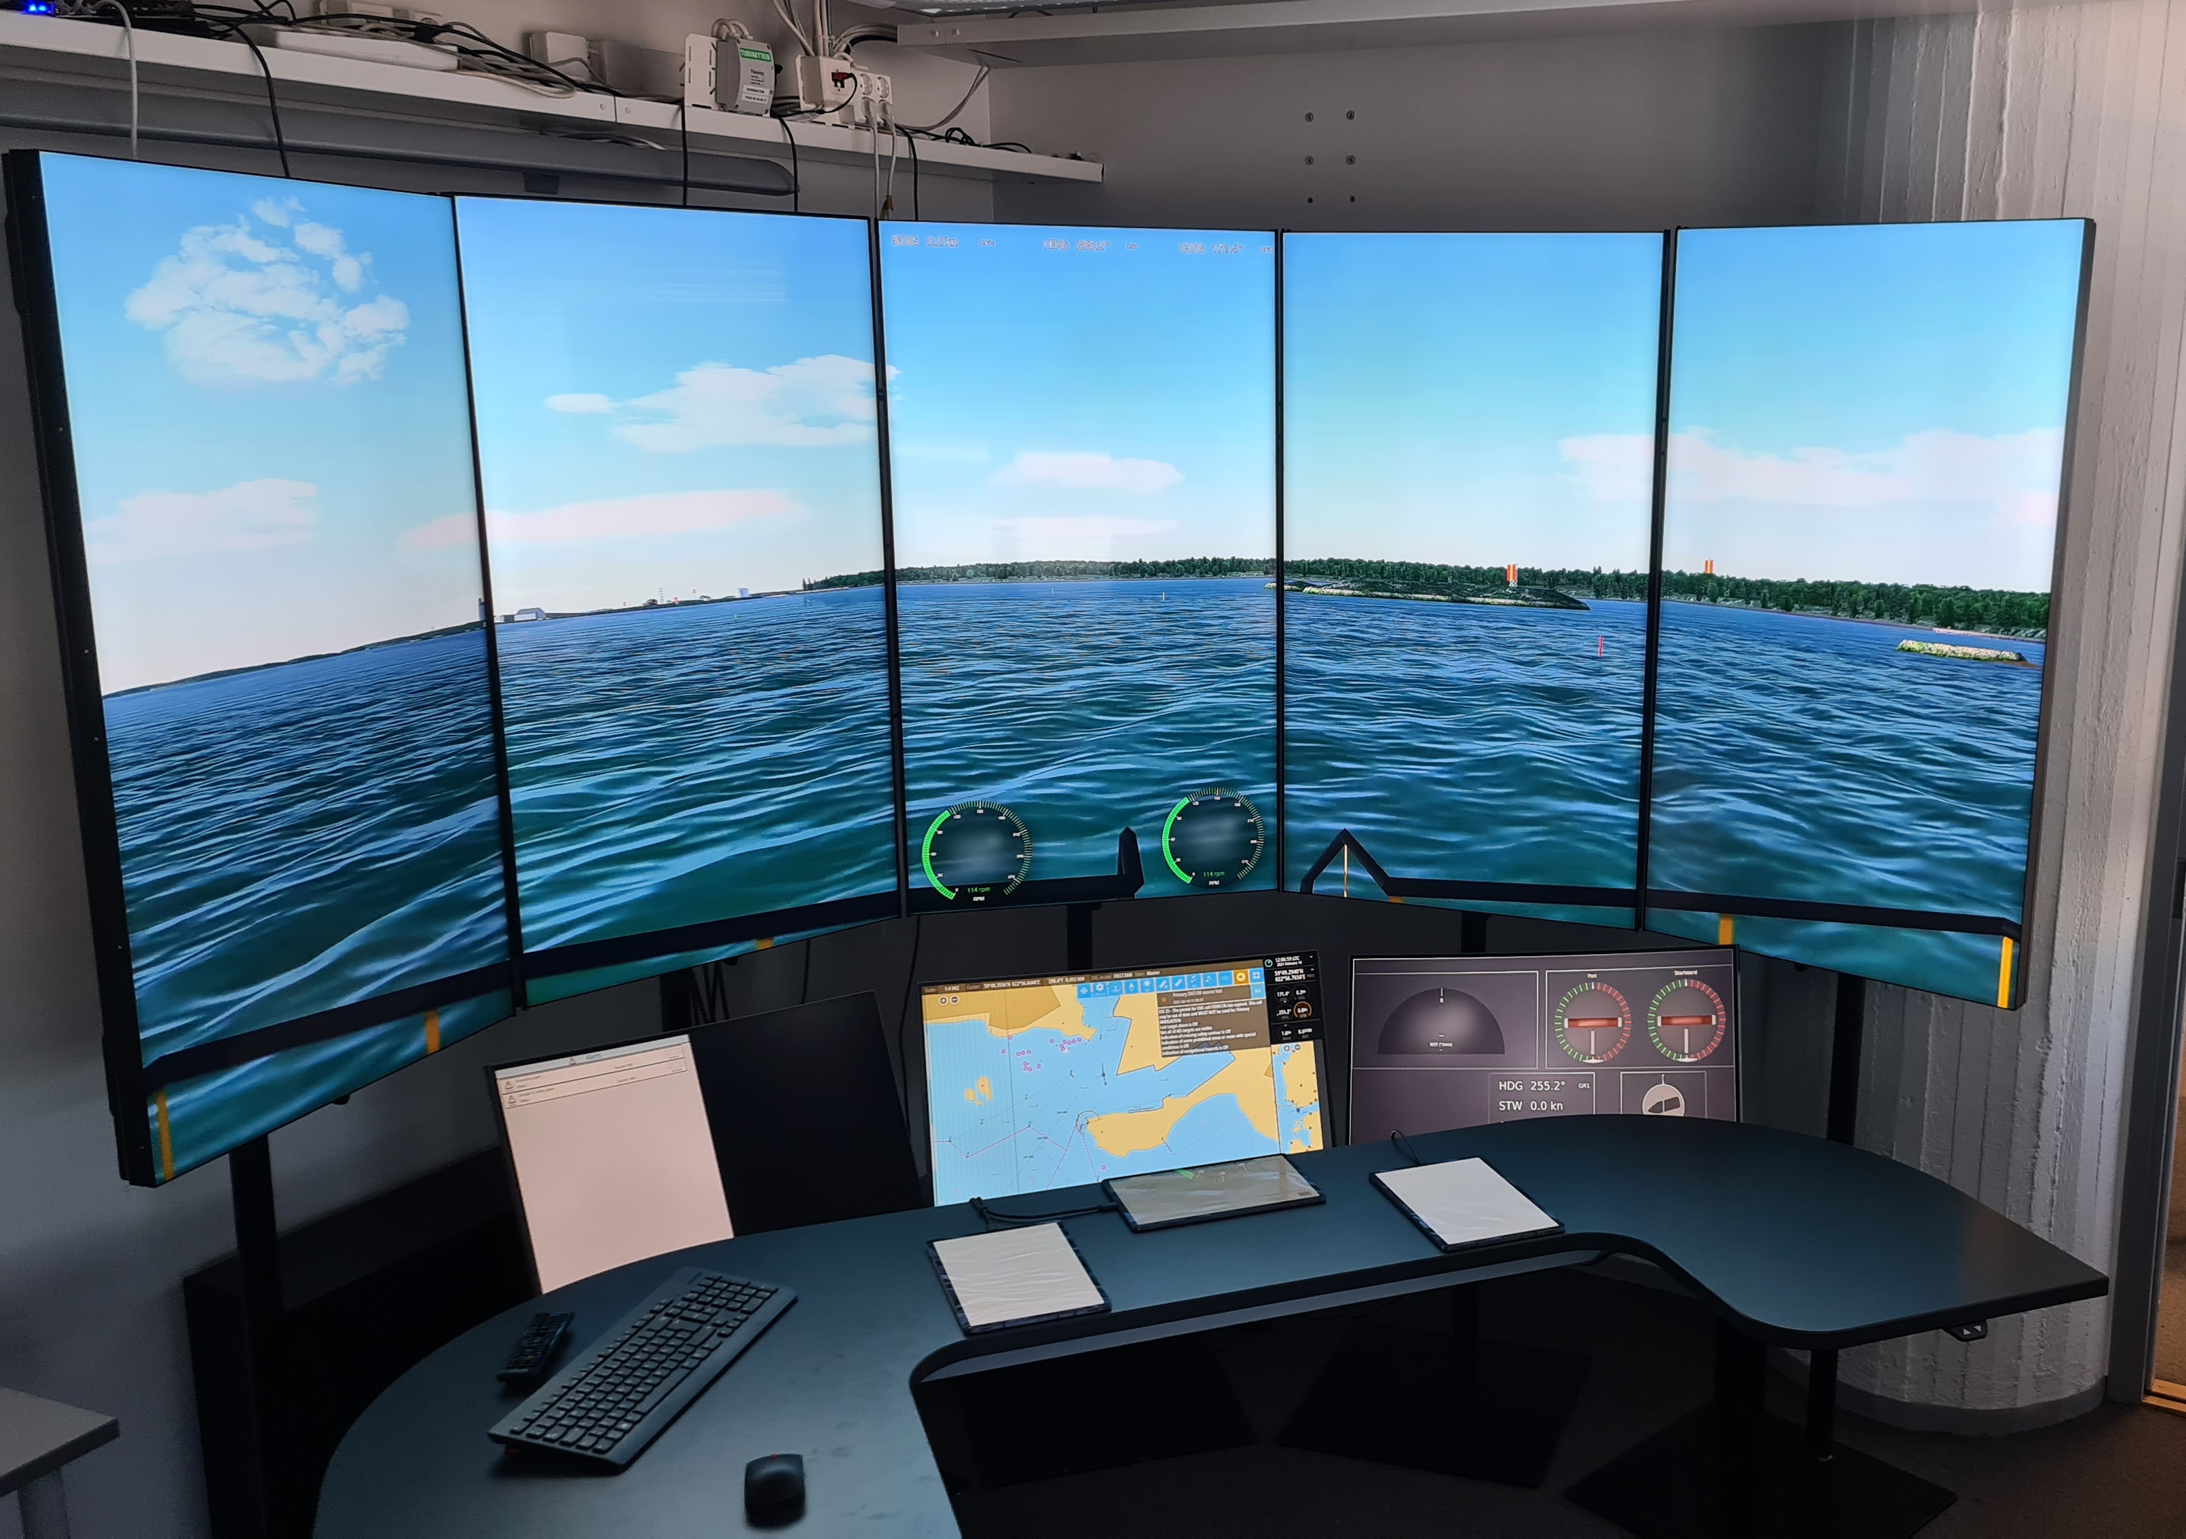
1. Maritime Remote Operator Station
Request and show various information streams from vessel
Allow for very flexible presentation of the information streams
Multiple screens
Open-source
Vue or other javascript tech ?

Slide 6
2. VRGP Implementation for ÅBoat
Implement vessel side of VRGP
Integration with sensors
Build and use “core” library
Open-source
WebRTC

Slide 7
3. Radar in VRGP
No really good standard for radar raw data, but Asterix-240 is usable.
Data is in the form of a time-series per slice, 360 slices per image
Compression of the Asterix stream of slices is not very effective
Idea: compose the image and treat as video
Open source
Algorithms, video streams, etc.
Research and publication possibility?

Slide 8
Others
Architect, and implement core of, a R&D maritime simulator with:
hierarchical simulations
modular, extensible
support for VR and AR
scales
can simulate at 100 * real-time
Scheduling tool for AboaMare
plans rooms and teachers across 3 organizations
constraint satisfaction tracking, and possibly solving
good UI for “what-if”

