Slide 1
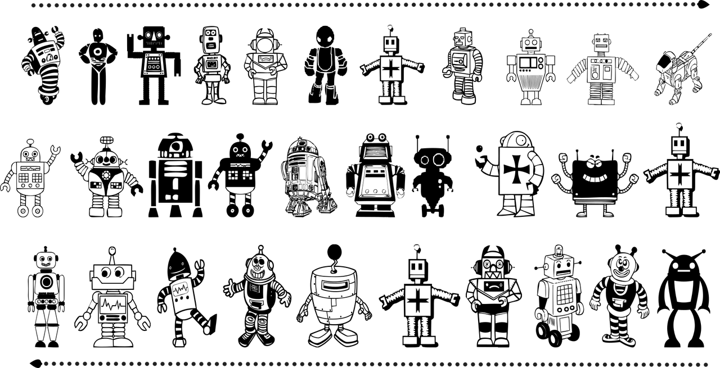
Robots and Norms
testing one or two research hypotheses

Slide 2
Social Robots for long-term interaction
Have to understand the rules in society which can differ between contexts
How we teach robots? How we design interaction?
Are there good solutions to connect textual info and physical environment?

Slide 3
The problem (not yet a task)
Do they UNDERSTAND words? (verbal representations of orientations in space: previous research, test of one trick, are there any working solutions?)
An example of current experimental research: Heikkilä, P., Lammi, H., Niemelä, M., Belhassein, K., Sarthou, G., Tammela, A., ... & Alami, R. (2019, November). Should a robot guide like a human? A qualitative four-phase study of a shopping mall robot. In International Conference on Social Robotics (pp. 548-557). Springer, Cham.

Slide 4
Research on Sociality in Robots
My trajectory:
long-term interaction
gamified sociality
roles for robots
…
gaps in theory
search for reliable models of context
are robots good in taking particular roles?
ethics
anthropomorphism
design
technology acceptance model
Can we tell them about their roles in every given physical environment?

Slide 5
My background
psychoanalysis, theatre and perception of art as topics of private interests
(what we see when we see what we see? who is showing and why? where?)
marketing, business strategy, therefore social science as academic background
symbolic representation as fascinating model for social facts
social constructivism as outdated theory ^.^
IS theory methodology epistemology for a gap in social robotics research
social engineering as conventional term for DESIGN (specifically in interaction)

Slide 6
Me as a customer (my expectation)
NLP team
strong marketing to share and exchange
and for nostalgic feeling (before the 2009 crisis markets blossomed?)
not clear can it be a company with own product or a solution for some Toyota
or at least a sample solution for your portfolio
let’s arrange a zoom call! ynikolae@abo.fi Julia

